Slide 1
Formal Verification of Run-to-completion Style Statecharts Using Event-B

Slide 2
OUTLINE
Introduction
Motivation
Background
SCXML
Event-B
UML-B Statemachine
Run-to-Completion
Model Construction
SCXML Model Translation to Event-B
Model Verification
Conclusions

Slide 3
Introduction

Slide 4
Motivation
Graphical languages are attractive to engineers (e.g. statecharts generalization of statemachines)
Rodin/Event-B support abstraction and refinement and enable the use of formal proofs in earlier stages of the design
There are many definitions of refinement, we are concerned with a refinement that preserves safety properties from one refinement level to the next
To enable our form of refinement statechart transitions cannot cross state containment boundaries arbitrarily.

Slide 5
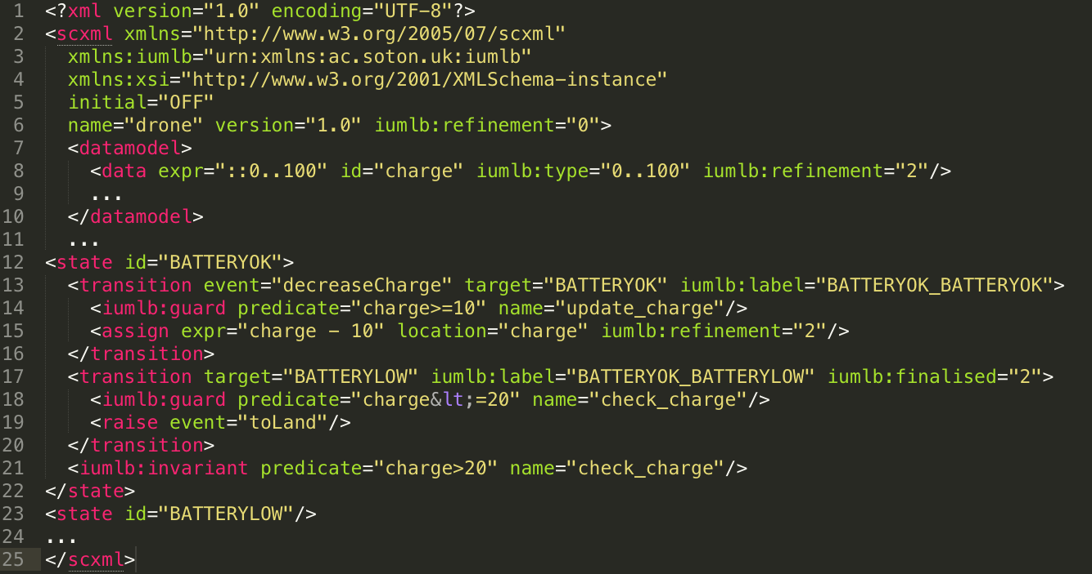
State Chart XML (SCXML)
Modeling language based on Harel statechart
Follow a run-to-completion semantics
Trigger events may enable transitions
Trigger events are queued whenever a trigger is raised
A trigger event is de-queued and consumed by firing all transitions that it enables
Enabled un-triggered transitions are taken repeatedly until none are enabled, and then the next trigger is de-queued
Internal triggers are raised by transitions within the model
External triggers are raise by the environment (non-deterministically)
Internal triggers have higher priority than external triggers
Notes:
Re “A trigger event is de-queued and consumed by firing all transitions that it enables” – of course they have to be in parrallel regions to all be enabled

Slide 6
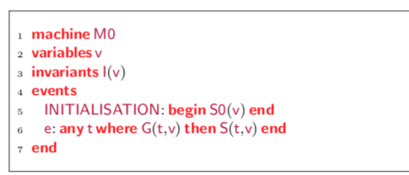
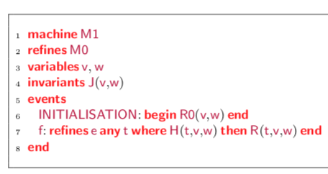
Event-B
Formal method for system design via refinement
Event-B models have two parts:
Contexts: Contain sets, constants and axioms
Machines: Variables, events, and invariants
Machines are refined to add more details to the model
Superposition refinement: including additional variables
Data refinement: replacing abstract variables with new concrete variables
New events: Refines implicit abstract event that does nothing “skip”
Notes:
Data refinement is not used by our SCXML models

Slide 7
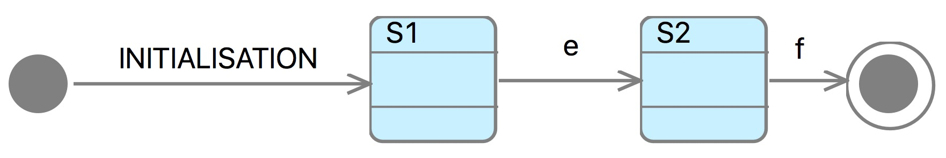
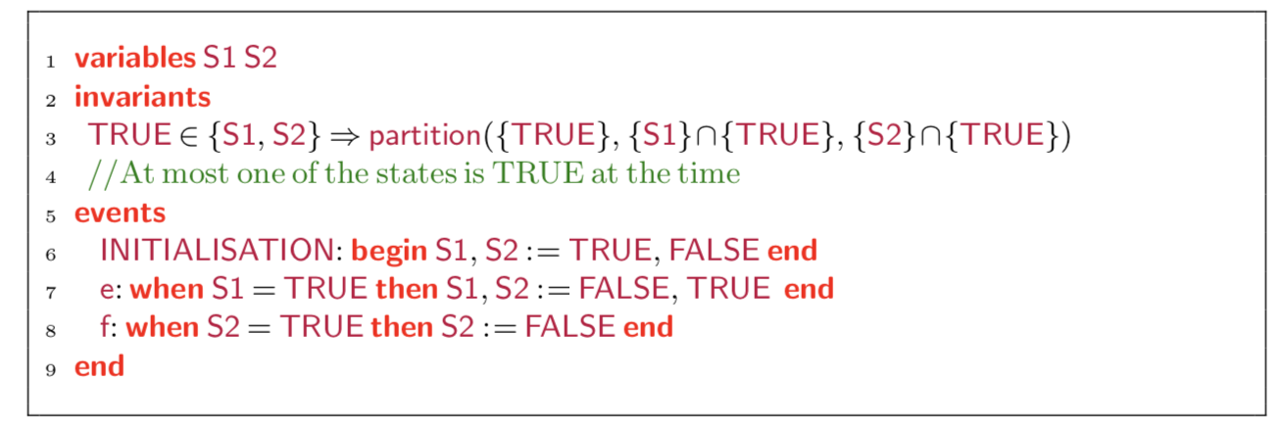
UML-B
Diagrammatic modeling notation for Event-B
Semantics is not UML nor run-to-completion
Only untriggered transitions
Encoding of State :
Boolean variables
Enumerated type
Refinements:
Superposition refinement: add nested statemachines
Guard strengthening: new guards concerning auxiliary variable
New Events: add self transitions

Slide 8
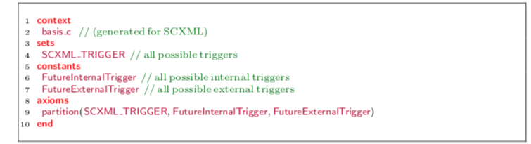
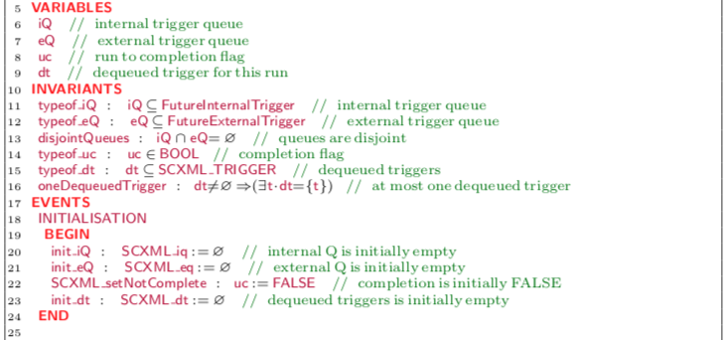
Run-to-Completion
Semantics is specified by an abstract basis that is extended by the model
The basis consist of an Event-B context and machine
Basis Context
Basis Machine

Slide 9
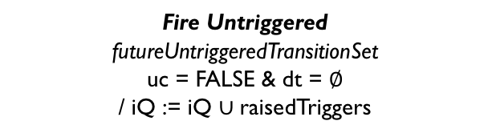
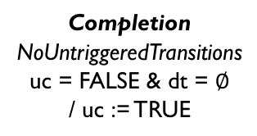
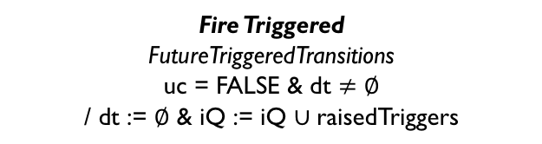
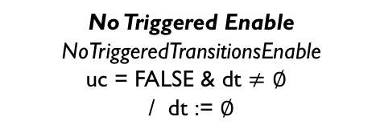
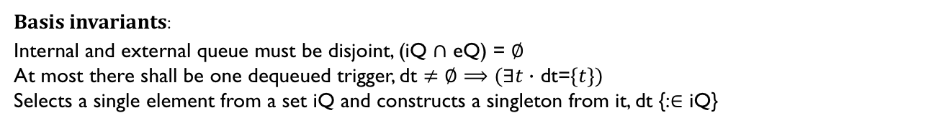
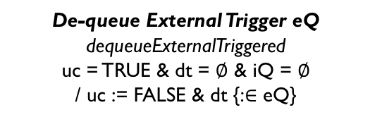
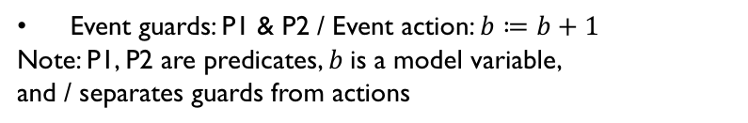
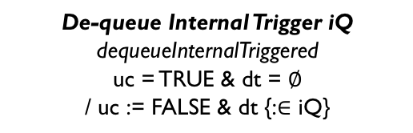
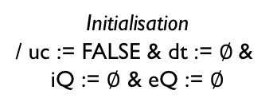
Statechart Like Representation of Run-to-completion Semantics
Firing Transitions
Fire Triggered
FutureTriggeredTransitions
uc = FALSE & dt $≠$ $∅$
/ dt := $∅$ & iQ := iQ $∪$raisedTriggers
Initialisation
/ uc := FALSE & dt := $∅$&
iQ := $∅$ & eQ := $∅$
FIRING
TRIGGERED
FIRING
UN-TRIGGERED
No Triggered Enable
NoTriggeredTransitionsEnable
uc = FALSE & dt $≠$ $∅$
/ dt := $∅$
Fire Untriggered
futureUntriggeredTransitionSet
uc = FALSE & dt = $∅$
/ iQ := iQ $∪$raisedTriggers
De-queue External Trigger eQ
dequeueExternalTriggered
uc = TRUE & dt = $∅$ & iQ = $∅$
/ uc := FALSE & dt {:$∈$ eQ}
De-queue Internal Trigger iQ
dequeueInternalTriggered
uc = TRUE & dt = $∅$
/ uc := FALSE & dt {:$∈$ iQ}
Completion
NoUntriggeredTransitions
uc = FALSE & dt = $∅$
/ uc := TRUE
READY TO DE-QUEUE
Bold+Italic: Short Description
Italic: Event-B event name
ALL CAPS: STATE NAMES
Event guards: P1 & P2 / Event action: $b≔b+1$
Note: P1, P2 are predicates, $b$is a model variable,
and / separates guards from actions
Basis invariants:
Internal and external queue must be disjoint, (iQ $∩$ eQ) = $∅$
At most there shall be one dequeued trigger, dt $≠$ $∅⟹(∃t∙$ dt=$\{t\})$
Selects a single element from a set iQ and constructs a singleton from it, dt {:$∈$ iQ}
Notes:
Make animation

Slide 10
Model Construction

Slide 11
Different Types of Refinement
Our Refinement Rules:
Nesting Rule : A statechart can be embedded within a state of another statechart
Guard Strengthening: Guard conditions on a transition can be strengthened
Action Strengthening: Transitions can have additional actions
Syriani et al. Refinement Rules:
Rule 2 basic-to-or state rule:
Rule 3 or-to- and-state rule:
Rule 7 state extension rule:
Rule 8 path refinement rule:
SB
SB
SB
SA
SA
SE
SG
SC
SD
SC
SD
SF
SH
SB
SB
SB
SA
SA
SC
SD
SE
SF
SC
SD
SA
SA
SB
SC
SD
SE
SC
SD
SB
SC
SD
SA
SB
SE
SF
x’=0
SA
/x’=x+1
SB
SA
SD
SB
SC

Slide 12
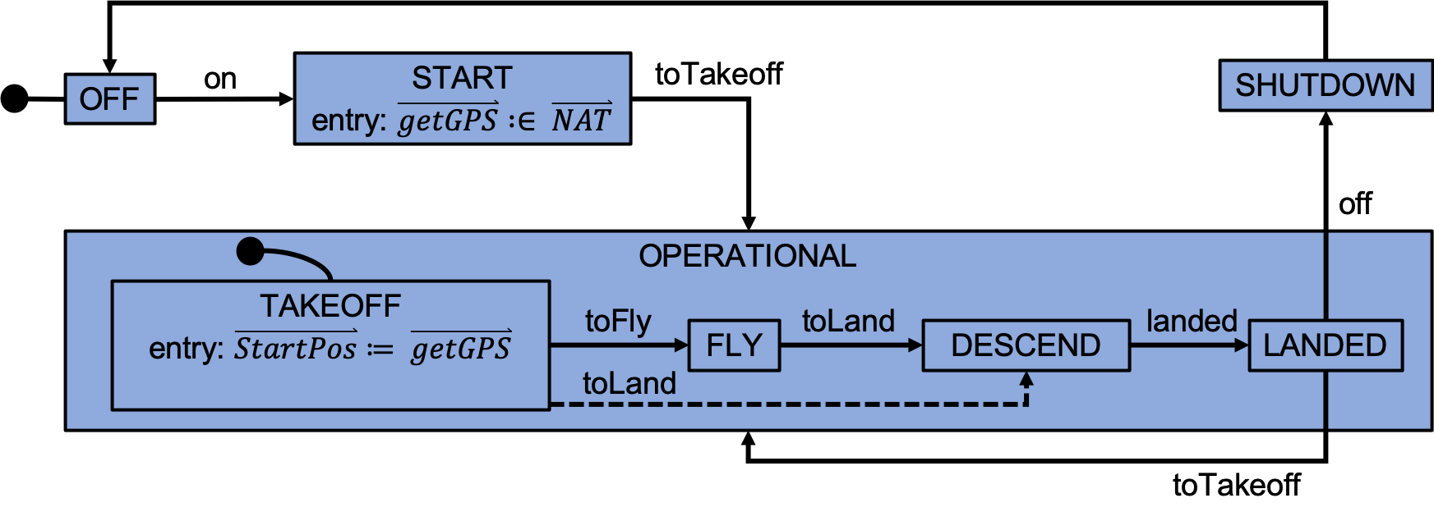
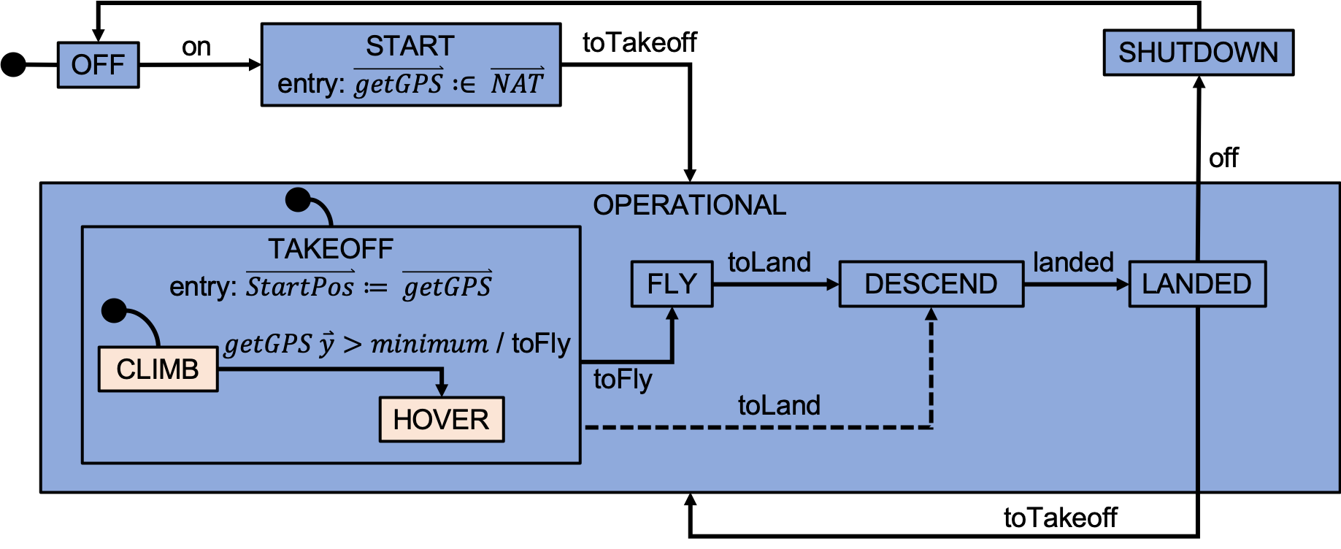
Quadrotor Helicopter Model Construction
First Abstract Model
Drone’s basic functionality
External Triggers: on, toTakeoff, off
Internal Triggers: toFly, toLand, landed
First Refinement Model
Apply nesting rule
Remove some non-determinism by explicitly raising internal trigger toFLy
Notes:
Abstraction: Rule 8 path refinement
First Refinement: Rule 2 basic-to-or state rule

Slide 13
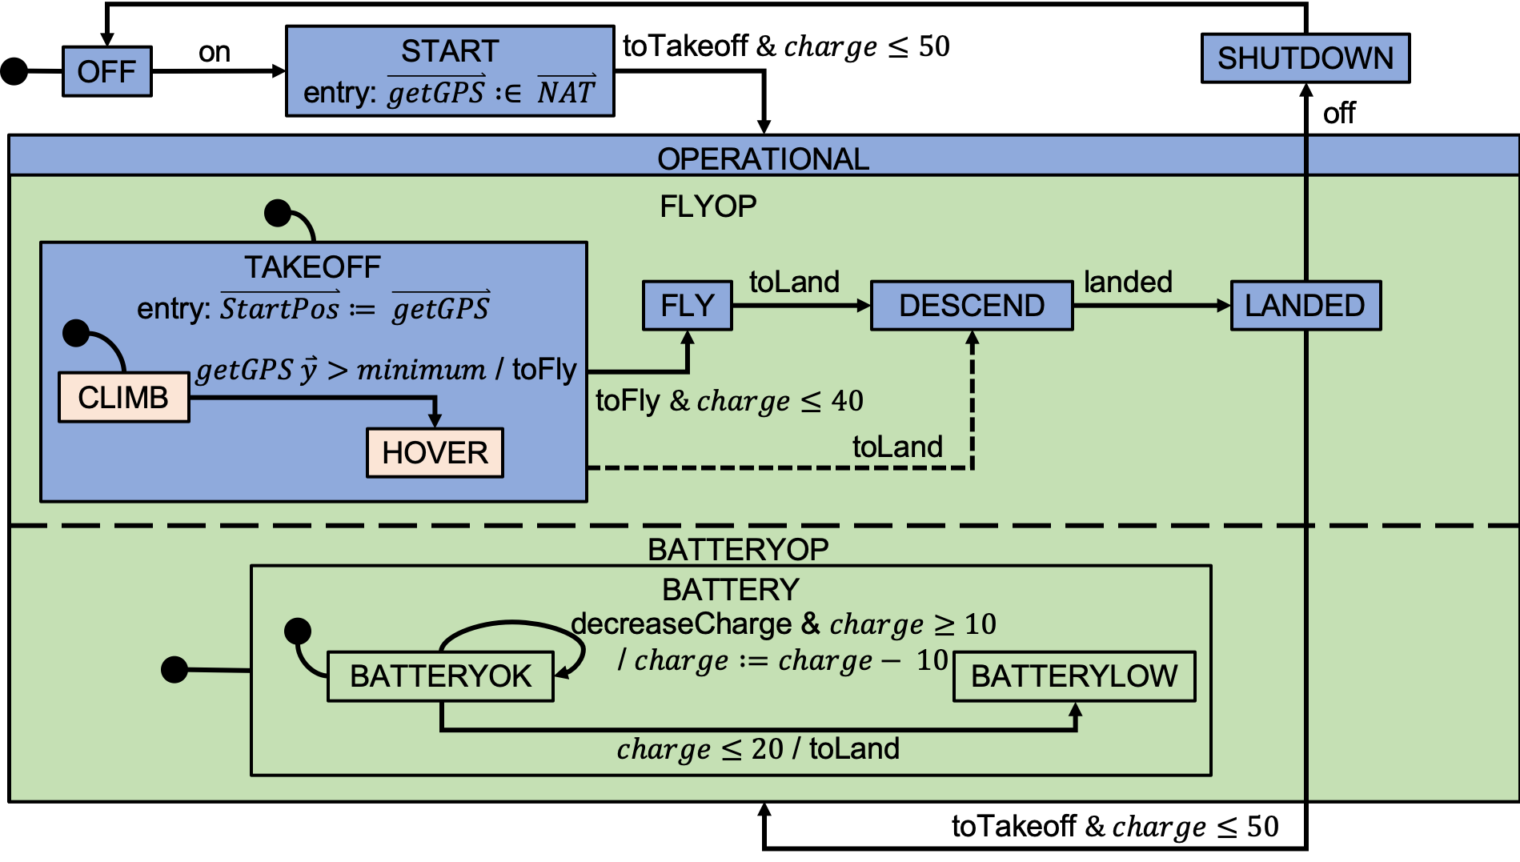
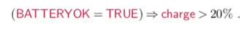
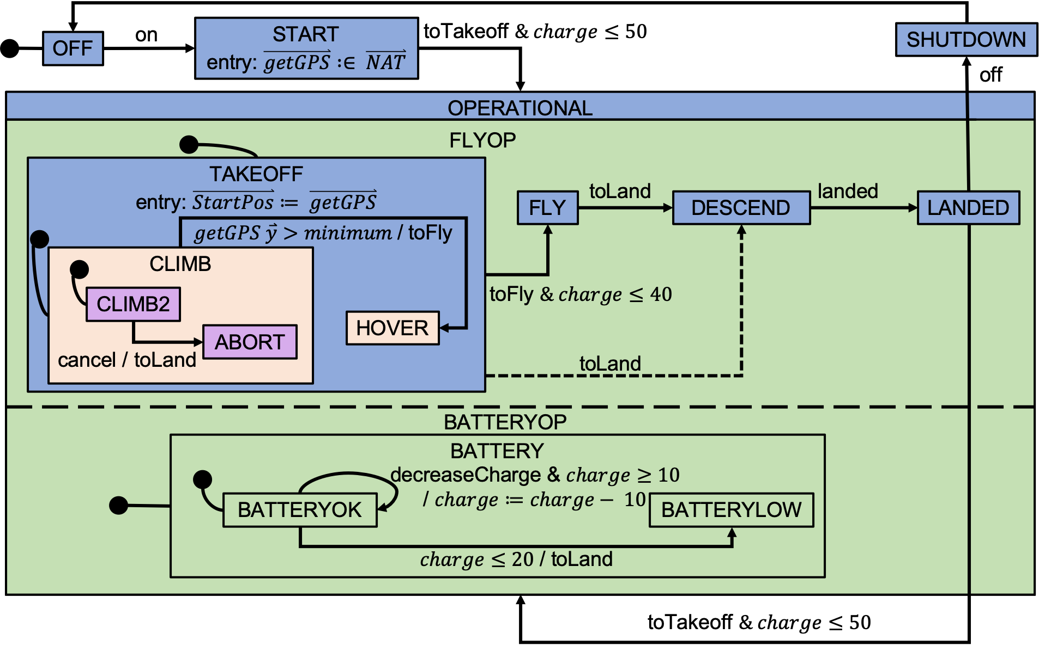
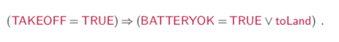
Quadrotor Helicopter Model Construction (cont.)
Second Refinement Model
Add capability to control flying and battery functionality (nesting rule)
The charge within the drone battery is monitored by the parallel BATTERYOP state.
New model variable and guard strengthening
Internal Triggers: decreaseCharge
Third Refinement Model
Add implementation details to be able to circumvent flying and proceed to an emergency landing (e.g when battery charge is too low)
Apply nesting rule
Notes:
Second refinement: Rule 4 and-state rule. Introduce a requirement to constrain drone operation to a battery charge of at least 20% capacity.
Third Refinement: Rule 7 state extension rule. data remapping of the abstract states TAKEOFF, CLIMB and HOVER, which should be distinct from the states in this refinement, as the state ABORT is introduced.

Slide 14
SCXML Model Translation to Event-B

Slide 15
SCXML Model Translation to Event-B
SCXML models are first translated to UML-B and subsequently to Event-B
Generation of the basis machine as context that captures generic run-to-completion semantic details
Generation of events that correspond to all possible combination of each set of transitions that can fire together
Translation of the SCXML statechart into the corresponding UML-B statemachine
Translation of the UML-B statemachine into the corresponding Event-B model

Slide 16
Model Verification

Slide 17
Verification of Safety Properties Using Theorem Provers
Example Requirement: The control system shall not continue to take off or fly if the battery charge drops below the threshold (say 21%).
System reacts to low battery charge
System subsequently leaves the FLY or TAKEOFF states
Ideal Property:
Actual Property:
Ideal Property:
Actual Property:

Slide 18
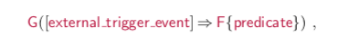
Verification of Control Responses Using LTL Model Checking
General form for liveness properties
General liveness property requires the assumption of strong fairness for all events in the model
Example Requirement: The battery charge shall decrease in value after an external trigger event decreaseCharge
The property fails to model check and should be revised as a consequence of the model structure
The controller only monitors battery charge while in the BATTERYOK state
Even it the precondition is true the presence of another trigger (e.g off) may take the controller out of the BATTERYOK state
Ideal Property:
Actual Property:

Slide 19
Conclusions and Future Work

Slide 20
Conclusions
We have demonstrated a technique for introducing refinement of reactive statecharts that can be translated into Event-B for verification.
Invariant properties about the expected coordination of states can be verified with the Rodin theorem prover. Because of the reactive nature of the system these are interpreted to hold only after the reaction is completed.
We use the LTL model checker to verify expected reactions to environmental triggers. Another kind of liveness property that would be useful to verify is that the ‘run’ converges to completion.
Notes:
I.e. transition loops and raised internal triggers do not introduce endless live- lock, but eventually terminate to allow the next external trigger to be consumed.

Slide 21
Future Work
Enable the verification of liveness properties using the Roding theorem prover instead of the LTL model checker
Extend the use of the ‘Scenario Checker’ tool and methods which can animate pre-defined domain specific scenarios at various levels of abstraction. The extension will enable automatic execution of the run to completion.
Formalize the semantics of the extended SCXML and refinement rules

Slide 22
QUESTIONS

Slide 23
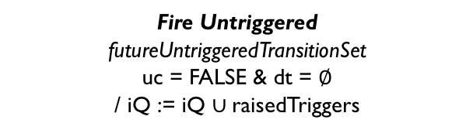
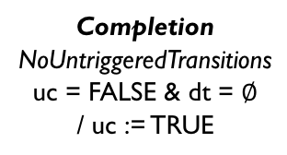
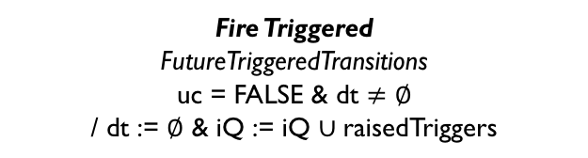
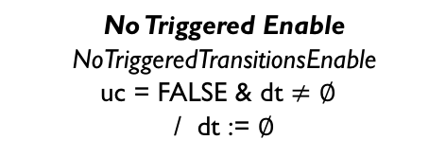
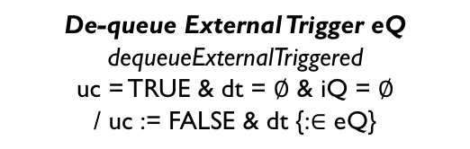
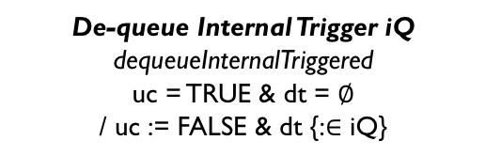
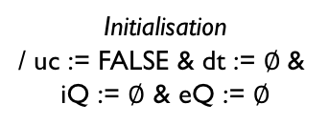
Statechart Like Representation of Run-to-completion Semantics
Firing Transitions
Fire Triggered
FutureTriggeredTransitions
uc = FALSE & dt $≠$ $∅$
/ dt := $∅$ & iQ := iQ $∪$raisedTriggers
Initialisation
/ uc := FALSE & dt := $∅$&
iQ := $∅$ & eQ := $∅$
FIRING
TRIGGERED
FIRING
UN-TRIGGERED
No Triggered Enable
NoTriggeredTransitionsEnable
uc = FALSE & dt $≠$ $∅$
/ dt := $∅$
Fire Untriggered
futureUntriggeredTransitionSet
uc = FALSE & dt = $∅$
/ iQ := iQ $∪$raisedTriggers
De-queue External Trigger eQ
dequeueExternalTriggered
uc = TRUE & dt = $∅$ & iQ = $∅$
/ uc := FALSE & dt {:$∈$ eQ}
De-queue Internal Trigger iQ
dequeueInternalTriggered
uc = TRUE & dt = $∅$
/ uc := FALSE & dt {:$∈$ iQ}
Completion
NoUntriggeredTransitions
uc = FALSE & dt = $∅$
/ uc := TRUE
READY TO DE-QUEUE
Bold+Italic: Short Description
Italic: Event-B event name
ALL CAPS: STATE NAMES
Event guards: P1 & P2 / Event action: $b≔b+1$
Note: P1, P2 are predicates, $b$is a model variable,
and / separates guards from actions
Basis invariants:
Internal and external queue must be disjoint, (iQ $∩$ eQ) = $∅$
At most there shall be one dequeued trigger, dt $≠$ $∅⟹(∃t∙$ dt=$\{t\})$
Selects a single element from a set iQ and constructs a singleton from it, dt {:$∈$ iQ}
Notes:
Make animation

Slide 24
Different Types of Refinement
Our Refinement Rules:
Nesting Rule : A statechart can be embedded within a state of another statechart
Guard Strengthening: Guard conditions on a transition can be strengthened
Action Strengthening: Transitions can have additional actions
Syriani et al. Refinement Rules:
Rule 2 basic-to-or state rule:
Rule 3 or-to- and-state rule:
Rule 7 state extension rule:
Rule 8 path refinement rule:
SB
SB
SB
SA
SA
SE
SG
SC
SD
SC
SD
SF
SH
SB
SB
SB
SA
SA
SC
SD
SE
SF
SC
SD
SA
SA
SB
SC
SD
SE
SC
SD
SB
SC
SD
SA
SB
SE
SF
x’=0
SA
/x’=x+1
SB
SA
SD
SB
SC

